Slide 1
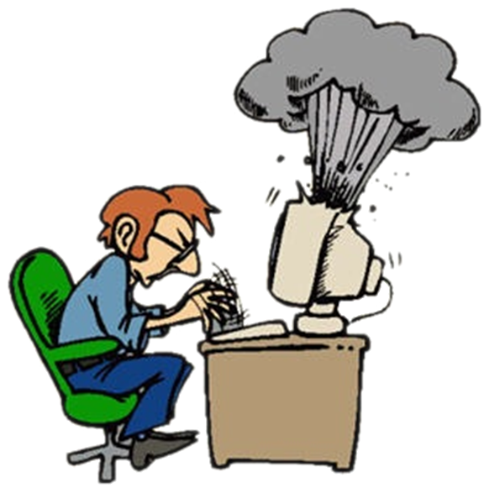

Computer systems (hardware)
Hardware questions

Slide 2
Question
Which memory type loses it’s content when power is removed from the system:
EEPROM
SRAM
flash
ROM
All of the above

Slide 3
Answer
SRAM
SRAM stands for static random-access memory. RAM memory is volatile, and its state is lost or resets when power is removed from the system. The SRAM is generally faster and requires less power than DRAM and, in modern computers, it is often used as cache memory for the CPU.
Reference :
http://www.webopedia.com/TERM/R/RAM.html

Slide 4



Computer programs (software)
Computer software

Slide 5
Question
Which is the most popular game development language?
Objective-C
C++
Smalltalk
C#
Python

Slide 6
Answer
C++
C++ is used when you have to program applications that require very close work with the hardware or that have special performance requirements (like 3D games).
Reference:
http://en.wikipedia.org/wiki/Game_programming

Slide 7


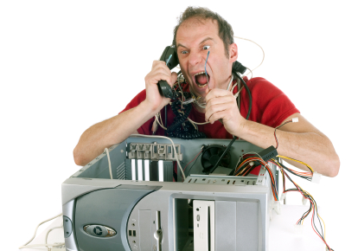
Rules for working with and supporting computer systems
Installing, usage, support, …

Slide 8
Question
You have set a BIOS password on a personal computer. How will you restart the BIOS if you have forgotten the password?
I will reinstall the operating system
I will remove the processor and mount it back
I will search for a jumper called CMOS, move it and put it back
I will remove the RAM and the HDD and put them back

Slide 9
Answer
The BIOS is the basic instruction set that "teaches" the computer how to access its media. If the BIOS is password protected, the computer will not function without the password. BIOS passwords are used in two ways: To prevent modification of the BIOS settings and to completely stop the computer from booting.
Reference :
http://www.wikihow.com/Break-a-BIOS-Password
http://cryptome.org/isp-spy/bios-spy.pdf

Slide 10

Means of data transfer in IT, Numeral systems
Channels for data transmission, measurement units, work with number systems

Slide 11
Question
Which standard is used for broadcasting a terrestrial digital television in Bulgaria?
DVB-S
MPEG4
HDTV
DVB-T

Slide 12
Answer
Digital Video Broadcasting (DVB) is a suite of internationally accepted open standards for digital television. These standards define the physical layer and data link layer of the distribution system. All data is transmitted in MPEG transport streams. Most common standards are: DVB-S, DVB-C, DVB-T (terrestrial) etc.
Reference :
http://en.wikipedia.org/wiki/Digital_Video_Broadcasting
http://www.dvb.org/standards/factsheets

Slide 13





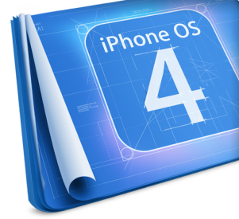








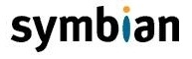
Operational Systems
Architecture, processes, users, user interfaces, file systems

Slide 14
Question
What device runs on an embedded operating system?
a mainframe
a PDA
a desktop PC
None of the above

Slide 15
Answer
Reference about the question:
Embedded operating systems are designed to be used in embedded computer systems. They are designed to operate on small machines like PDAs with less autonomy. They are able to operate with a limited number of resources. They are very compact and extremely efficient by design.
http://en.wikipedia.org/wiki/Operating_system#Embedded

Slide 16

Software engineering and project development
Analysis, specifications, projects, prototypes, implementation, testing, support, …

Slide 17
Question
What is R.A.D. in the context of the software development process?
Repeated Affiliation Of Domains
Real-time Asynchronous Deployment
Rapid Application Development
Report Analyze Develop

Slide 18
Answer
Rapid application development R.A.D is a software development methodology that uses minimal planning in favor of rapid prototyping. The "planning" is interleaved with writing the software itself. RAD allows software to be written much faster, and makes it easier to change requirements.
Reference:
http://en.wikipedia.org/wiki/Rapid_application_development

Slide 19




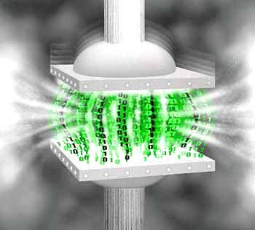




Compressing and decompressing data
Compression algorithms, archive software

Slide 20
Question
The two types of compression are:
With memorizing and without memorizing
With losses and without losses
With encoding and without encoding
With hashing and without hashing

Slide 21
Answer
The compression can be lossless (when it is possible to reconstruct the original data) or lossy (reconstruction is only possible to a degree, though the lost information may be impossible to notice by the human eye or ear)
Reference:
http://en.wikipedia.org/wiki/Data_compression
http://tuj.asenevtsi.com/Media/M18.htm
http://www.computers.bg/teoriq_na_kompresiqta.html

Slide 22



Text processing software and file formats
Working with word processing software, file formats, coding, text, tables, figures, ...

Slide 23
Question
What is the most used encoding on the World Wide Web?
UTF-8
ASCII
UTF-7
UTF-32
Not possible to determine

Slide 24
Answer
UTF-8 has become the dominant character encoding for the World Wide Web, accounting for more than half of all Web pages.
Reference:
http://en.wikipedia.org/wiki/UTF-8
http://encoding.spec.whatwg.org/
Elektronen Kurs Po Programirane-1 (Tema 44)

Slide 25




Computer graphics
Raster and vector graphics, graphic file formats, image editors, range of colors

Slide 26
Question
How many bits are needed to store the color of each pixel in a black and white image?
16 bits
8 bits
2 bits
1 bit

Slide 27
Answer
1 bit
Color depth aka bit depth is the number of bits used to indicate the color of each pixel.
Black and white images have only two colors so only one color is present in each pixel.
Reference:
http://it.jovkov.org/12_klas/colors/urok_color.htm
http://en.wikipedia.org/wiki/Color_depth
http://www.cambridgeincolour.com/tutorials/bit-depth.htm

Slide 28

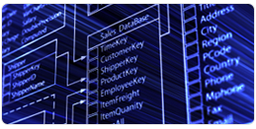


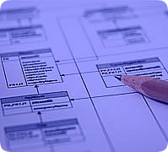

Databases
Data models, tables, relationships, SQL

Slide 29
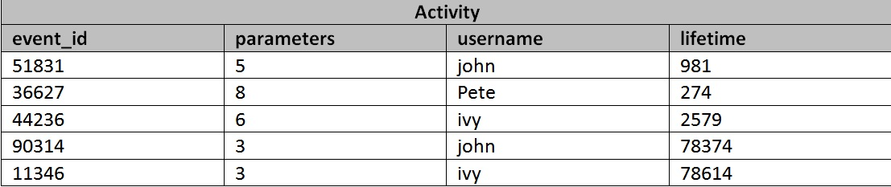
Question
How can you obtain the number of events triggered by each user from the given table:
SELECT username, event_id FROM Activity
SELECT username, COUNT(event_id) FROM Activity GROUP BY username
SELECT * FROM Activity
SELECT username, event_id FROM Activity WHERE event_id > 12311

Slide 30
Answer
SELECT username, COUNT(event_id) FROM Activity GROUP BY username
Selects the username from table Activity, counts how many events are associated with that username and displays the result
Reference:
http://sqlzoo.net/
http://telerikacademy.com/Courses/Courses/Details/12
http://www.w3schools.com/sql/

Slide 31

Information systems
ERP, CRM, BI, BPM, FMIS, CAD/CAM, CMS, software architectures

Slide 32
Question
One of the most used information system class is ERP. The abbreviation stands for:
Economic Resource Planning
Enterprise Records Pack
Economic Recovery Planning
Enterprise Resource Planning
Electromagnetic Rocket Pack

Slide 33
Answer
Enterprise resource planning (ERP) is business management software—usually a suite of integrated applications—that a company uses to manage business processes, including
Reference:
http://en.wikipedia.org/wiki/Enterprise_resource_planning

Slide 34


Security
Symmetrical and asymmetrical coding algorithms, cryptographic hash, digital signature, digital certificates

Slide 35
Question
The penetration test is designed to test the computer and network security. Such simulated attacks are performed from:
External source
Internal source
Both external and internal source
None of the above

Slide 36
Answer
A penetration test, occasionally pentest, is a method of evaluating computer and network security by simulating an attack on a computer system or network from external and internal threats.
Reference:
http://en.wikipedia.org/wiki/Penetration_test

Slide 37




Presentation making & Presentation skills
Presentation software, preparation of presentations, slides, effects, notes, colors, images, sound, video

Slide 38
Question
Which of the following is NOT presentation software:
CorelDRAW
Google Docs
Apple Keynote
SlideRocket
Prezi
280 Slides

Slide 39
Answer
CorelDRAW - vector graphics editor;
All others are presentation programs:
Google Docs is free
Sliderocket – delivered as SaaS. The platform is being integrated into ClearSlide.
Prezi – cloud based presentation software
280 Slides – a free web-based presentation software closed down in December 2011.

Slide 40
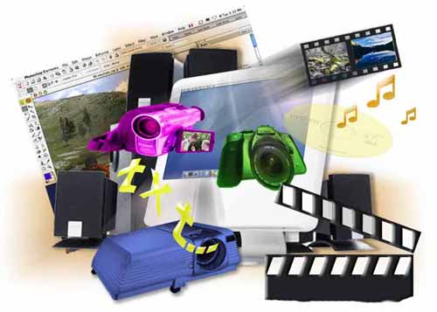



Multimedia
Software creation / processing media: audio, video, file formats

Slide 41
Question
Which of the following is an audio codec?
WMA
H.264
DivX
WMV
VP9

Slide 42
Answer
WMA – Windows Media Audio
WMV – Windows Media Video
VP9 – video compression standard by Google
Reference:
http://en.wikipedia.org/wiki/Codec
http://en.wikipedia.org/wiki/List_of_codecs
http://en.wikipedia.org/wiki/Windows_Media_Audio

Slide 43


Computer networks
OSI model, Communications models, protocols, standards, hardware equipment

Slide 44
Question
Which of the following is not communication protocol:
FTP
POP3
TCP
DES

Slide 45
Answer
DES (The Data Encryption Standard) is a previously predominant algorithm for the encryption of electronic data.
Reference:
http://en.wikipedia.org/wiki/Communications_protocol
http://en.wikipedia.org/wiki/Data_Encryption_Standard

Slide 46
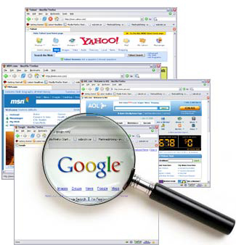


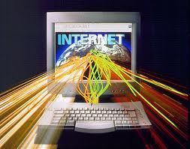
Internet
Internet, protocols, services, WWW, HTTP, FTP, SMTP, POP3, IMAP, WebDAV, IP, DNS, …

Slide 47
Question
Which of the following is not internet protocol:
FTP
HTTP
UDP
SOAP

Slide 48
Answer
All of the above are communications protocol but SOAP (Simple Object Access Protocol) is a protocol specification for exchanging structured information in the implementation of Web Services in computer networks.
Reference:
http://en.wikipedia.org/wiki/List_of_network_protocols
http://searchsoa.techtarget.com/definition/SOAP

Slide 49





Electronic communication and e-mail
E-mail, Skype, ICQ, IRC, MSN Messenger, Yahoo Messenger, Social networks, forums, …

Slide 50
Question
Which of the following is a proprietary, closed source, P2P VoIP application layer protocol?
Skype protocol
HTTP
XMPP/Jingle
SMTP
IAX

Slide 51
Answer
The Skype protocol is a proprietary* Internet telephony (VoIP) network based on peer-to-peer architecture, used by Skype. Its specifications are not publicly available and official applications using the protocol are closed-source.
The other protocols in the list are either not VoIP, not P2P or open( not proprietary).
*Proprietary - restricted from uses, such as modification, sharing, studying, redistribution, or reverse engineering.

Slide 52




World Wide Web (WWW)
How does WWW work? HTTP, GET, POST, URL, web browser, web pages, web site, …

Slide 53
Question
Which of the following is NOT true about Authoritative name server?
Returns answers to queries about domain names
Can either be master or slave (replicas of master)
Only returns answers to queries about domain names in its configuration system
Gives answers that were obtained via a regular DNS query to another name server.

Slide 54
Answer
An authoritative name server provides answers to DNS queries about domain names that have been configured by an original source, for example the domain administrator, in contrast to answers that were obtained via a regular DNS query to another name server. Can be master or slave.
Reference:
http://www.dnsknowledge.com/whatis/authoritative-name-server/

Slide 55




Web Front-end and Design
Web design, HTML, CSS, text, graphics, references, tables, forms, ...

Slide 56
Question
Which of the following CMS is based on Microsoft technology:
Drupal
DotNetNuke
Joomla
Wordpress
TextPattern
SilverStripe

Slide 57
Answer
DotNetNuke (DNN) is based on ASP.NET, the rest are written in PHP.
Reference:
http://en.wikipedia.org/wiki/DotNetNuke
http://www.makeuseof.com/tag/10-popular-content-management-systems-online/
http://net.tutsplus.com/articles/web-roundups/top-10-most-usable-content-management-systems/

Slide 58





Web scripting languages
Development of scripts with JavaScript, basic JavaScript constructs, operators, objects, manipulation of DOM tree

Slide 59
Question
In the context of web development, which of the following languages is typically run on the client side:
Ruby
Python
PHP
JavaScript
Perl

Slide 60
Answer
Although JavaScript can run server side, from the languages listed as answers, only JavaScript can run on the client (in the web browser).
Reference:
http://stackoverflow.com/questions/15270648/client-side-scripting-and-server-side-scripting-languages
what-are-the-difference-between-server-side-and-client-side-programming
http://www.codeconquest.com/website/client-side-vs-server-side/

Slide 61
Telerik Acadamy for students
?
?
?
?
?
Questions?
?
?
?
?
?
http://schoolacademy.telerik.com

